Slide 1
CS 575
Design and Analysis of
Computer Algorithms
Professor Michal Cutler
LCS

Slide 2
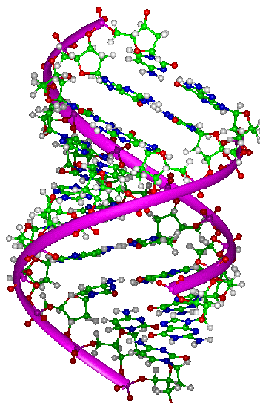

Biological
Applications
Compare the DNA of two or more organisms
How similar are the two strands?
Is one a substring of the other?
Find a new longest strand in which the bases (A, C, G, T) appear in the same order as in the original 2 strands?

Slide 3
Longest Common Subsequence (LCS)
Problem: Given sequences x[1..m] and y[1..n], find a longest common subsequence of both.
Example: x=ABCBDAB and y=BDCABA,
  BCA is a common subsequence and
  BCBA and BDAB are two LCSs

Slide 4
LCS
Brute force solution
Writing a recurrence equation
The dynamic programming solution
Application of algorithm

Slide 5
Brute force solution
Solution: For every subsequence of x, check if it is a subsequence of y.
Analysis :
  There are 2^{m} subsequences of x.
  Each check takes Ο(n) time, since we scan y for first element, and then scan for second element, etc.
  The worst case running time is Ο(n2^{m}) or Ω(2^{m}).

Slide 6
Writing the recurrence equation
Let X_{i} denote the ith prefix x[1,..i] of x[1..,m], and
X₀ denotes an empty prefix
We will first compute the length of an LCS of X_{m} and Y_{n}, LenLCS(m, n), and then use information saved during the computation for finding the actual subsequence
We need a recursive formula for computing LenLCS(i, j).

Slide 7
Writing the recurrence equation
If X_{i} and Y_{j} end with the same character x_{i}=y_{j}, there is an LCS that includes the character. Otherwise we could get a longer LCS by adding the common character.
If X_{i} and Y_{j} do not end with the same character there are two possibilities:
  either the LCS does not end with x_{i},
  or it does not end with y_{j}
Let Z_{k} denote an LCS of X_{i} and Y_{j}

Slide 8
X_{i} and Y_{j} end with x_{i}=y_{j}
X_{i}
x₁ x₂ … x_{i-1} x_{i}
Y_{j}
y₁ y₂ … y_{j-1} y_{j}=x_{i}
Z_{k}
z₁ z₂…z_{k-1} z_{k} =y_{j}=x_{i}
Z_{k} is Z_{k -1} followed by z_{k} = y_{j} = x_{i} where
Z_{k-1} is an LCS of X_{i-1} and Y_{j -1} and
LenLCS(i, j)=LenLCS(i-1, j-1)+1

Slide 9
X_{i} and Y_{j} end with x_{i} ≠ y_{j}
X_{i}
x₁ x₂ … x_{i-1} x_{i}
X_{i}
x₁ x₂ … x_{i-1} x _{i}
Y_{j}
y₁ y₂ … y_{j-1} y_{j}
Y_{j}
y_{j} y₁ y₂ …y_{j-1} y_{j}
Z_{k}
z₁ z₂…z_{k-1} z_{k} ≠y_{j}
Z_{k}
z₁ z₂…z_{k-1} z_{k} ≠ x_{i}
Z_{k} is an LCS of X_{i} and Y_{j -1}
Z_{k} is an LCS of X_{i -1} and Y_{j}
LenLCS(i, j)=max{LenLCS(i, j-1), LenLCS(i-1, j)}

Slide 10
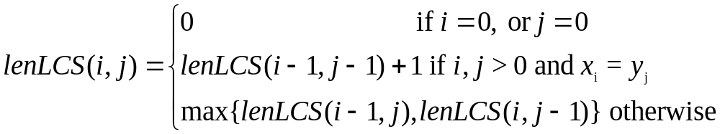
The recurrence equation

Slide 11
The dynamic programming solution
Initialize the first row and the first column of the matrix LenLCS to 0
Calculate LenLCS (1, j) for j = 1,…, n
Then the LenLCS (2, j) for j = 1,…, n, etc.
Store also in a table an arrow pointing to the array element that was used in the computation.
It is easy to see that the computation is O(mn)

Slide 12
LCS-Length(X, Y)
(correction of pseudo code in Cormen)
//array starts with index 0
m ← length[X}
n ← length[Y]
for i ← 0 to m do
c[i, 0] ← 0
for j ← 0 to n do
c[0, j] ← 0

Slide 13
LCS-Length(X, Y) cont.
for i ← 1 to m do
for j ← 1 to n do
if x_{i} = y_{j}
c[i, j] ← c[i-1, j-1]+1
b[i, j] ← “D”
else
if c[i-1, j] ≥ c[i, j-1]
c[i, j] ← c[i-1, j]
b[i, j] ← “U”
else
c[i, j] ← c[i, j-1]
b[i, j] ← “L”
return c and b

Slide 14
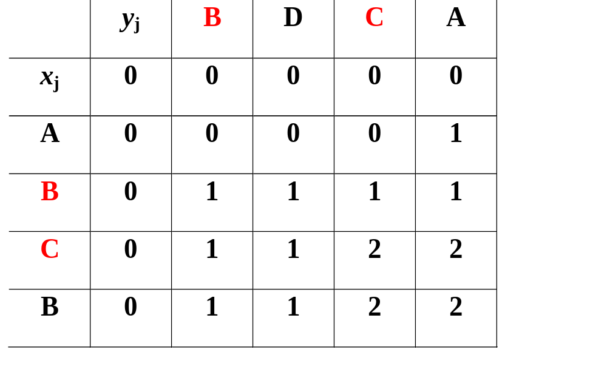
Example
To find an LCS follow the arrows, each diagonal arrow
denotes a member of the LCS

